Slide 1

Individual Conceptual Design
By:
Alex Reinert

Slide 2






Agenda
Introduction
Design Requirements
Design
Electrical Components
Coding
Questions
Notes:
Ian Slide

Slide 3




Introduction
</>
Alex Reinert
Systems Engineer

Slide 4
Review of the Problem Statement
Transporting heavy furniture up or down one flight of straight stairs is difficult and potentially dangerous.
</>
Notes:
Natalie Slide

Slide 5
Review of Design Requirements
1.1 The system shall cause less injury and strain than an average moving job.
1.2 The system shall not destructively alter the environment.
1.3 The system shall not damage the furniture.
2.1 The system shall transport furniture repeatedly up or down one floor within a residential building.
2.2 The system shall accommodate up to a 4-seater sofa.
2.3 The system shall accommodate up to a 5-shelf bookshelf.
2.4 The system shall be reusable.
3.1 The system shall fit within a standard stairway according to Section R311.7.1 of the 2021 International Residential Code (IRC).
3.2 The system shall be transportable in the back of an average American pickup truck in addition to the transported furniture.
</>

Slide 6
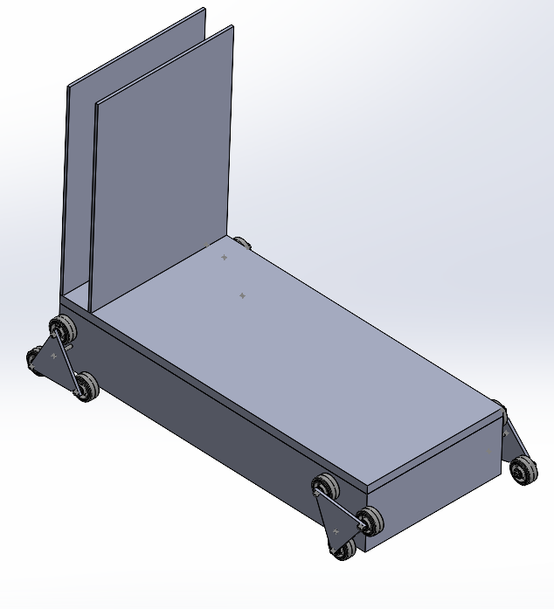
Design
Spring-Backing
Composite bed
</>
Tri-star Wheel
Electronic Storage

Slide 7
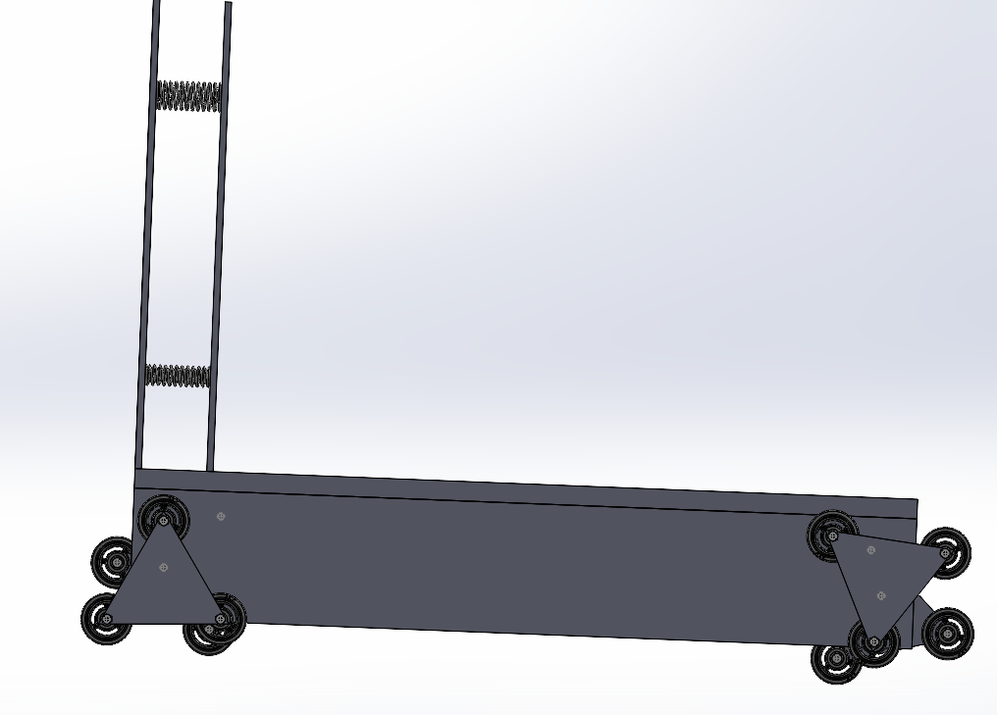
Design
Springs

Slide 8
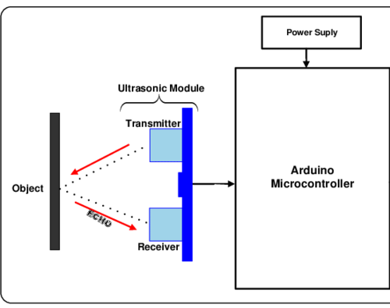
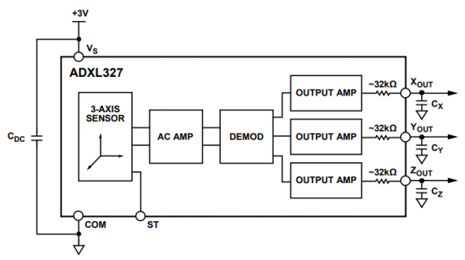
Electrical Components
</>
Ultrasonic Sensor
Tilt Sensor

Slide 9
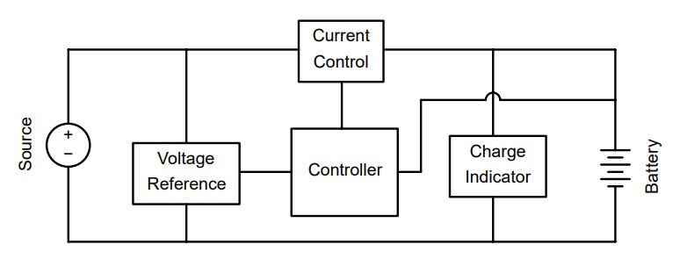
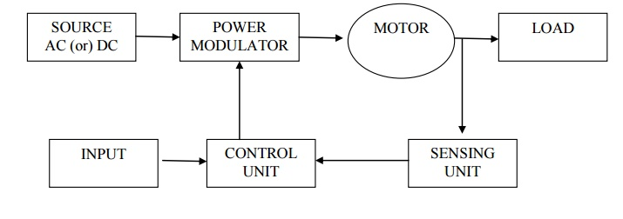
Electrical Components
</>
Rechargeable Battery
Generic Motor Block Diagram

Slide 10
Coding
Start
Turn on motor
True
Increase speed to motors to go upstairs
Does Ultrasonic Sensor detect an object?
False
False
Does tilt sensor detect an incline?
Does tilt sensor detect a landing?
Does tilt sensor detect a landing?
Keep constant motor speed
Decrease Speed for going downstairs
True
True
False
Slow down motor for flat surface
</>
Keep constant motor speed
False
Does tilt sensor detect a landing?
True
Increase speed for flat surface
Keep constant motor speed
Stop

Slide 11
Questions?
</>

Slide 12
References
Getz, R. (2021). Functional Block Diagram of ADXL327. Analog Devices. Retrieved September 24, 2023, from https://wiki.analog.com/university/labs/2_axis_tilt_sensor_adalm2000.
Kart, B. (2018). Block Diagram of an Electrical Drives. Brain Kart. Retrieved September 24, 2023, from https://www.brainkart.com/article/Block-Diagram-of-an-Electrical-Drives_12673/.
McMaster-Carr, T. (2017a). Compression Spring. United States; McMaster-Carr.
McMaster-Carr, T. (2017b). High-Strength Rubber Wheel. China; McMaster-Carr.
McMaster-Carr, T. (2017c). Rotary Shaft. United States; McMaster-Carr.
McMaster-Carr, T. (2017d). Zinc-Plated Steel Wheel Axle. China; McMaster-Carr.
Orji, E. (2018). System Block Diagram. ResearchGate. Retrieved September 24, 2023, from https://www.researchgate.net/figure/System-Block-Diagram_fig1_336253681.
Sheppard, J. (2021). Basics of Battery Charging Circuit Design. Battery Power Tips. Retrieved September 24, 2023, from https://www.batterypowertips.com/basics-of-battery-charging-circuit-design-faq/.

